Slide 1



CLIENT Digital Analytics
View in Power BI
Last data refresh:
1/28/2021 3:39:05 PM UTC
Downloaded at:
2/23/2021 10:03:29 PM UTC

Slide 2
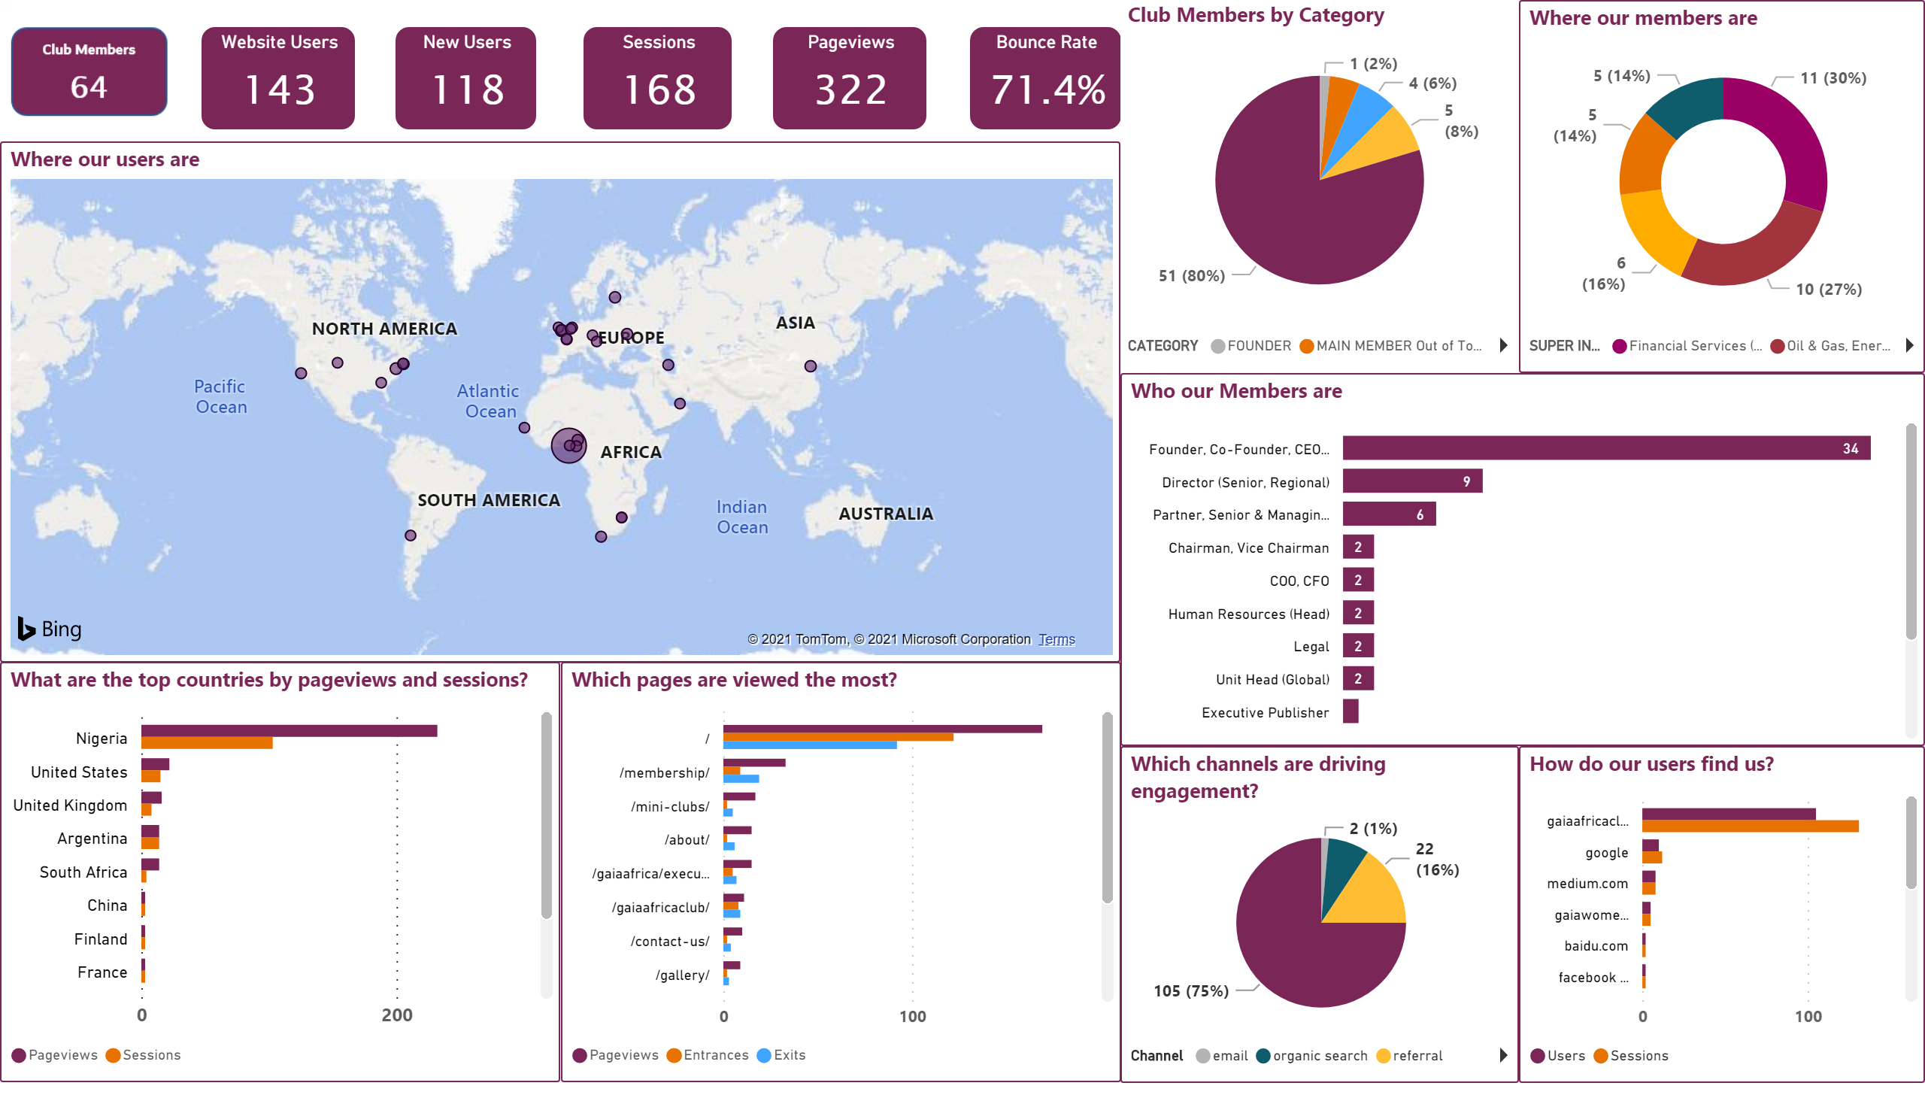
GAIA dashboard
Notes:
What are the top countries by pageviews and sessions?
No alt text provided.
Where our users are
No alt text provided.
Which channels are driving engagement?
No alt text provided.
How do our users find us?
No alt text provided.
Which pages are viewed the most?
No alt text provided.
Website Users
No alt text provided.
New Users
No alt text provided.
Sessions
No alt text provided.
Pageviews
No alt text provided.
Bounce Rate
No alt text provided.
Club Members by Category
No alt text provided.
Who our Members are
No alt text provided.
Where our members are
No alt text provided.
image
No alt text provided.

